Slide 1
Flexible Worksite Policy – August 2022

Slide 2
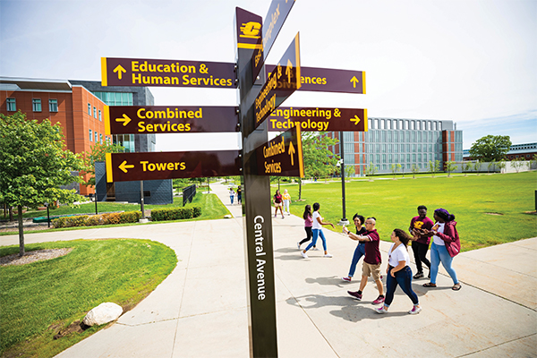
Background
Fundamental characteristics CMU:
  Residential campus – living/learning environment
  Strong sense of community
  Rewarding relationships
  Service to students must ensure offices are welcoming and responsive
  CMU work locations must be appropriately staffed
Generally, CMU place of employment is in-person, on-site
  Roles and functions of some will require physical presence

Slide 3

Purpose
  Establishes uniform guidance
  Assists in attracting and retaining employees
  Supports an effective work/life balance
  Supports institutional sustainability
  Enhances engagement and productivity
  Flexible Worksite Arrangement:
  management/employee agreement authorizing alternate worksite to assigned, in-person physical CMU owned/leased worksite

Slide 4

Applicability
Staff employees, Temporary Staff, Student Employees (rare) regularly assigned to work in-person at a CMU location
    –Includes staff employees for whose work CMU does not provide a CMU owned/leased physical worksite, and the work is required to be performed in that location. (Ex: Admissions in Chicago)
Based on:
  Nature of work performed
  Job responsibilities/work assignments
  Equipment required
  Employee performance
Individually assessed/case-by-case
Not organization-wide benefit, not an "employee right"

Slide 5

Exclusions
Short-term, unplanned, temporary circumstances
  Quarantine requirements, appointments, as examples
  Handled on a case-by-case basis with the approval of the supervisor
  A formal Flexible Worksite Agreement is not required
Remote work that may be required as a result of state or federal mandates

Slide 6

Flexible Worksite Locations
( For Staff working at a CMU Worksite)
Flexible worksite must be in Michigan or another state in the U.S. with an established physical CMU presence, such as a program center located in a CMU owned/leased building or military installation.
  – Temp staff working outside MI must be hired through employment agency
Change of a flexible worksite location must be approved by the supervisor, in advance
Employees are responsible for establishing a work environment free of interruptions and distractions that may impact performance
University may require a physical inspection of worksite
Policy is not designed to be a substitute for dependent care

Slide 7

Terms and Conditions of Employment
  Flexible Worksite arrangements are voluntary
  Expectations and responsibilities do not change
  All university and departmental rules, policies & procedures must continue to be observed
  Salary, benefits, vacation, sick leave, overtime and all other terms and conditions of employment remain the same

Slide 8

Flexible Worksite Agreement
  A Flexible Worksite Agreement is required to work remotely and is specific to the department, supervisor and position held.
  Must be approved by the Supervisor, Senior Manager, Division VP/Division Head and Human Resources prior to the employee signing and working from an alternative worksite
  Modified Agreements must be re-approved by the Supervisor, Senior Manager, Division VP/Division Head and Human Resources.
  Agreements must be reviewed at least annually
  Supervisor or employee may end the Agreement with a two weeks’ notice or immediately depending on circumstances; HR must be notified
  Termination of Agreement is not discipline or termination of employment; additional actions necessary

Slide 9

Liability
The university is not liable or responsible for:
  Damages to the flexible worksite;
  Cost of utilities or maintenance;
  Cost of renovation or creation of the designated workspace;
  Cost of compliance with zoning or insurance coverage;
  Tax implications of working remotely.
The university, in its sole discretion, may choose to cover certain job-related expenses as outlined in the Agreement and approved by the division head.
Employee is responsible for observing any municipal zoning ordinances or insurance requirements.
The flexible worksite shall not be used for physically meeting or conducting business with CMU employees, students or other individuals.

Slide 10

Work Hours/Performance
  Supervisors are responsible for:
    Monitoring hours and performance
    Holding their employee accountable
  Employees are responsible for:
    Meeting their work schedule responsibilities
    Performing the same quality of work
    Being available during established work hours
    Notifying supervisor if unavailable due to unexpected circumstances
  Performance must remain satisfactory
  Department requirements take precedence
  Supervisor may require employee to be in-person
    Employee will be responsible for the cost of transportation.

Slide 11

Workplace Safety and Security
Employees are responsible for:
  Maintaining a designated, safe, and secure environment
  Maintaining an ergonomically correct environment
  Ergonomics Toolbox:
  https://www2.cmich.edu/fas/hr/HRBenefitsandWellness/Pages/Ergonomics.aspx
Work-related Personal Injuries:
  Employee must immediately report injuries to their supervisor
  The employee or supervisor must also report the injury as soon as possible to Workers' Compensation at x7177.

Slide 12

Technology, Equipment, Confidentiality and Security
Supervisors will determine what equipment is provided, as approved by the division head
Employees are responsible for:
  Maintaining adequate internet and phone service
  Meeting encryption and security protocols (data must not be stored on personal computers)
  Maintaining confidentiality and security of university information (i.e. HIPAA and FERPA compliance)
  Ensuring all work information is protected and secured as outlined in the IT policies outlined in the Agreement.
  Reporting breaches of information confidentiality or security to their supervisor immediately.

Slide 13

Procedure
Three forms are necessary for establishing a
Flexible Worksite arrangement.
Flexible Worksite Request Form (completed by employee)
Flexible Worksite Checklist (completed by supervisor)
Flexible Worksite Agreement (completed by supervisor and employee)
Employees whose job duties may be performed from a remote location should discuss their interest with their immediate supervisor. If supported, employee completes a Flexible Worksite Request Form.
Supervisor must then determine whether a flexible worksite would be mutually beneficial to the employee and the university by completing the Flexible Worksite Checklist.
  Consider operational needs, employee suitability, impact on students, coworkers, and the public including onsite coverage and any other concerns that may impact service and productivity.

Slide 14

Procedure (Continued)
If the Flexible Worksite arrangement is mutually agreed upon and supported by both the employee and immediate supervisor, a Flexible Worksite Agreement is completed.
  Employee does not provide signature on the Agreement until all other signatures up chain of command are received.
Signed agreement is proposed by the immediate supervisor up the chain of command including the Senior Manager & Division Head for consideration and approval.
  Changes may be made at the discretion of leadership based on the needs of the department.
Once all approvals are achieved the immediate supervisor will review the agreement and any changes made by senior leadership with the employee and obtain employee signature.

Slide 15

Procedure (continued)
The Flexible Worksite Request Form, Checklist and Agreement containing all signatures are submitted to HR.
HR provides a final signed copy of the Agreement to the supervisor, employee, and the senior manager.
  Requests that are not supported will be communicated to the Employee by the supervisor.
  In that situation, a copy of the request and rationale for the denial are retained by the supervisor.
Employee may begin working from the Flexible Worksite when all signatures have been secured and HR returns a final copy to the employee, supervisor, and senior manager.
  All Flexible Worksite arrangements must have a signed Agreement in place and on file with Human Resources. Agreements are reviewed at least annually to determine continuation and/or changes.
    Any changes made to the Agreement should be documented, will require approval through the division head, and forwarded to HR with supporting rationale.

Slide 16
Next Steps
Supervisor sessions scheduled for 8/8 and 8/9
  General Counsel will add the policy to the online Administrative Policy Manual
  HR website will be updated with a link to the policy and the forms
Communication to the supervisor listserve that the documents are available online
Not planning a communication to all staff – it's not applicable to all staff – tool for supervisors to assist with recruitment, retention, engagement
Consider how you which employees might impact and how you will engage discussions

